Slide 1
GL PROPOSAL

Slide 2
Schedule:
August 12th – Planning Commission Public Hearing – Comprehensive Plan changes
August 31st (potential rollover September 1) - Board of County Commission Transmittal Public Hearing – Comprehensive Plan changes
October 6th – Zoning Commission Public Hearing – Zoning petitions
October 27th – Board of County Commission Adoption Public Hearing – Comprehensive Plan changes and Zoning petitions

Slide 3
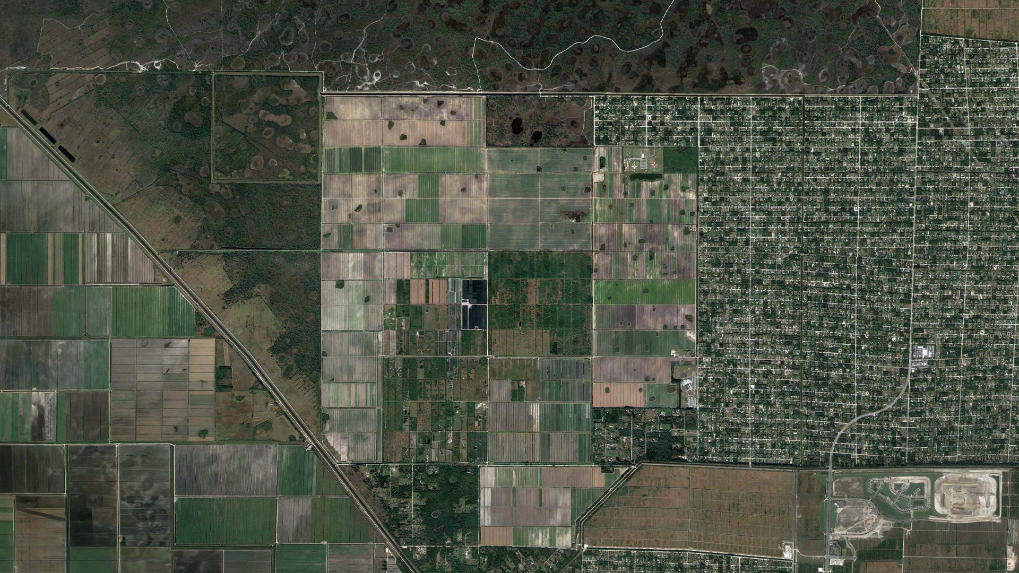
INDIAN TRAILS GROVE (AS APPROVED)
I.T.I.D
640 Acres
I.T.G. Ag/Water Resources
1,068 Acres
Indian Trails Grove
4,872 Total Acres
Indian Trails Grove
3,164 Developable Area and 3,897 residential units
Notes:
Sample Text with Clicks:
This (CLICK) is the Indian Trails Grove Property…
As currently approved…
(CLICK) This is the 640 acres, ITID area…
(CLICK) This is the 1,068 acres ITG Ag/Water Resources area…
This changes the developable area (CLICK) to 3,164 acres…
(CLICK)

Slide 4
INDIAN TRAILS GROVE (AS PROPOSED)
I.T.I.D
640 Acres
I.T.G. Ag/Water Resources
448 Acres
P.B.C. Ag/Water Resources
1,600 Acres
Indian Trails Grove
4,866 Total Acres
Indian Trails Grove
2,178 Acres Developable Area and reduce residential units from 3,897 to 2,612 units (a reduction of 1,285 units).
Notes:
Sample Text with Clicks:
Under the new proposal…
We have the (CLICK) 4,866-acre Indian Trails Grove Property…
(CLICK) There is the same proposed 640 acres, ITID area…
(CLICK) Then we have the proposed 1,600 acres PBC Ag/Water Resources area…
(CLICK) We also have the proposed 448 acres ITG Additional Preservation area…
This changes the developable area (CLICK) to 2,178 acres…
(CLICK)

Slide 5
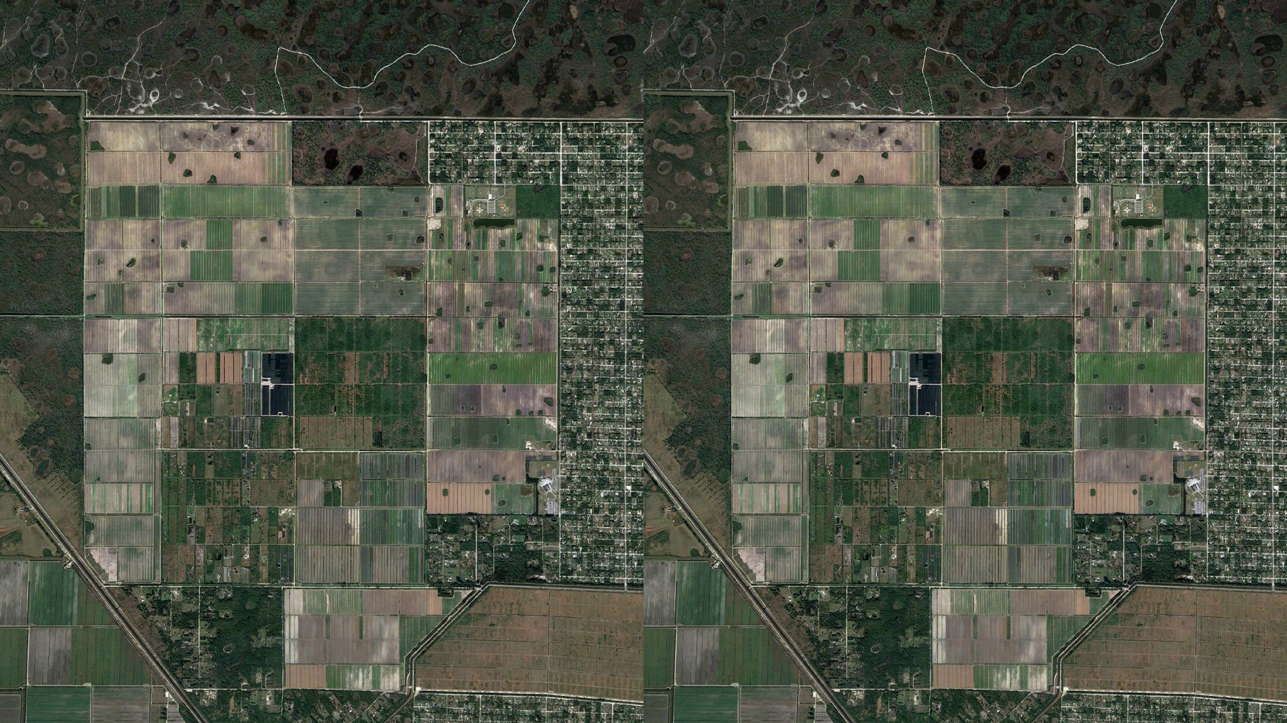
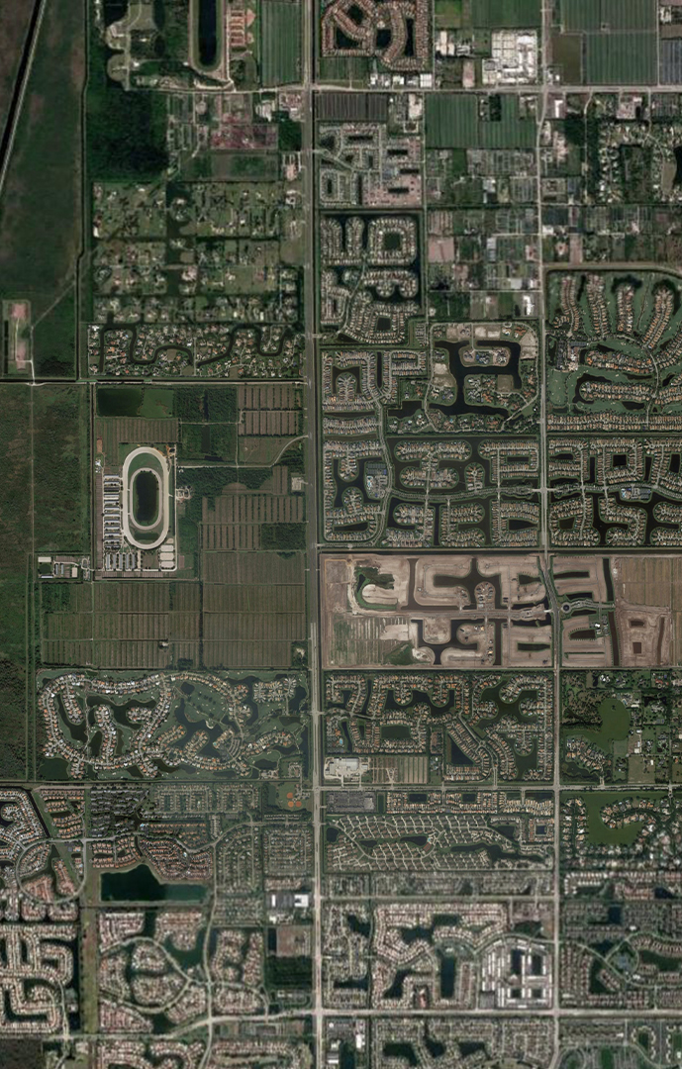
GL UPDATED Proposal
INDIAN TRAILS GROVE
HYDER WEST
I.T.I.D.
640 Acres
Construct and Dedicate to PBC 100 Acres
Passive Park
2,178 Acres
GL Homes will deed to P.B.C. 1,600 Acres & Design, Permit and Convey to PBC the Water Project
Dedicate to PBC 25 Acres of Public Civic sites and GL constructs 277 WFH Units
477 Acres
Construct 1,000 unit Adult Restricted PUD
Notes:
Sample Text with Clicks:
This slide shows the Indian Trails Grove Property and Hyder West…
This area (CLICK) is the 1600 acres…
Then on Hyder West…
(CLICK) 100 Preserve Acres…
and (CLICK) 104 acres civic purposes…
(CLICK)

Slide 6
INDIAN TRAILS GROVE
1,708 Acres
Preserved
2,682 Acres
Preserved
Increase of
974 acres
Approved Preserve Acres
Proposed Preserve Acres
Notes:
Sample Text with Clicks:
This side-by-side graphic shows a comparison…
With the approved plan (CLICK) 1,708 acres is preserved…
Under the proposed plan (CLICK) 2,682 acres will be preserved…
The county would stand to gain…
(CLICK) 974 additional acres…
(CLICK)

Slide 7
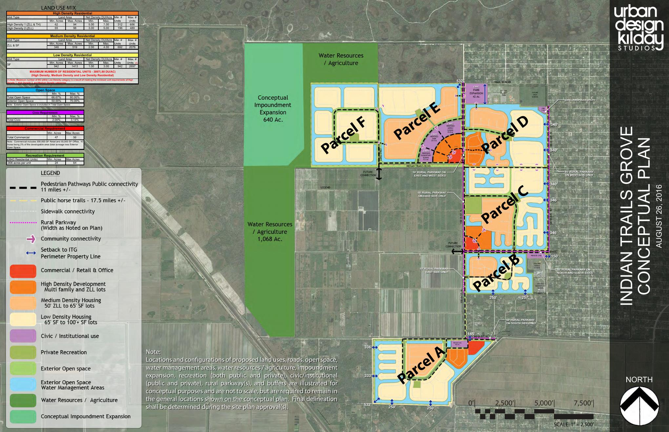

Slide 8
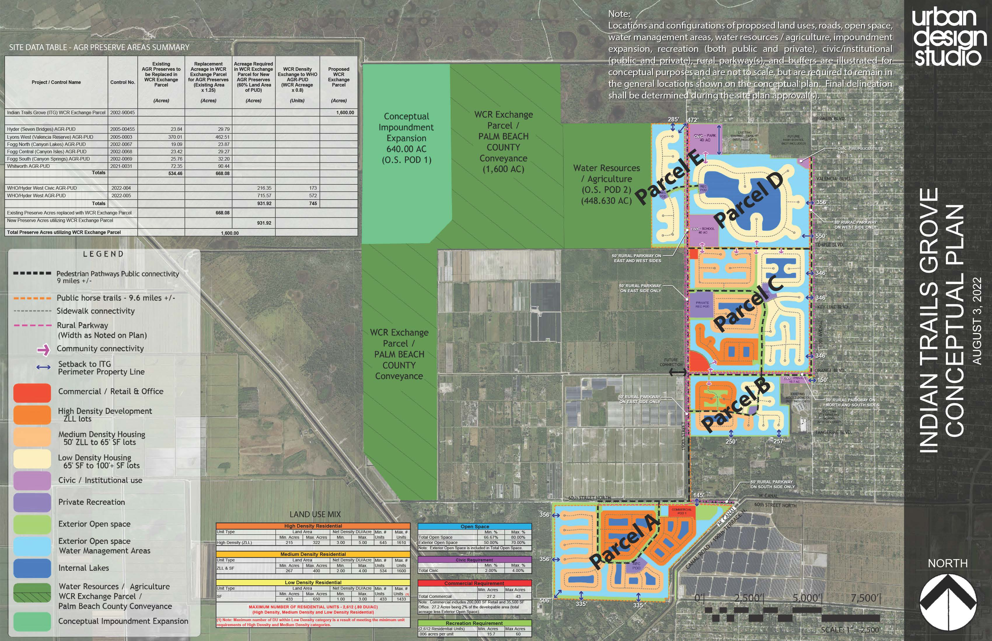

Slide 9
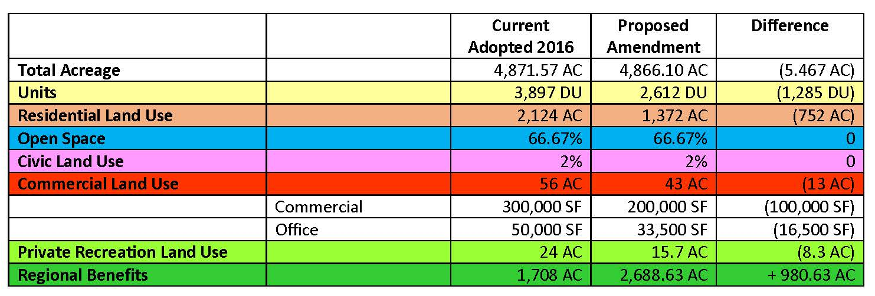
Indian Trails Grove Site Specific Future Land Use Atlas Amendment Request
Decrease in Intensity
Reduction in units and associated non-residential development
Increase in Regional Benefits
Increase of +980 Ac. in lands designated for Agriculture/Water Resources
Increase in acres of land Publicly Dedicated – 640 Ac. PLUS 1,600 Ac.

Slide 11
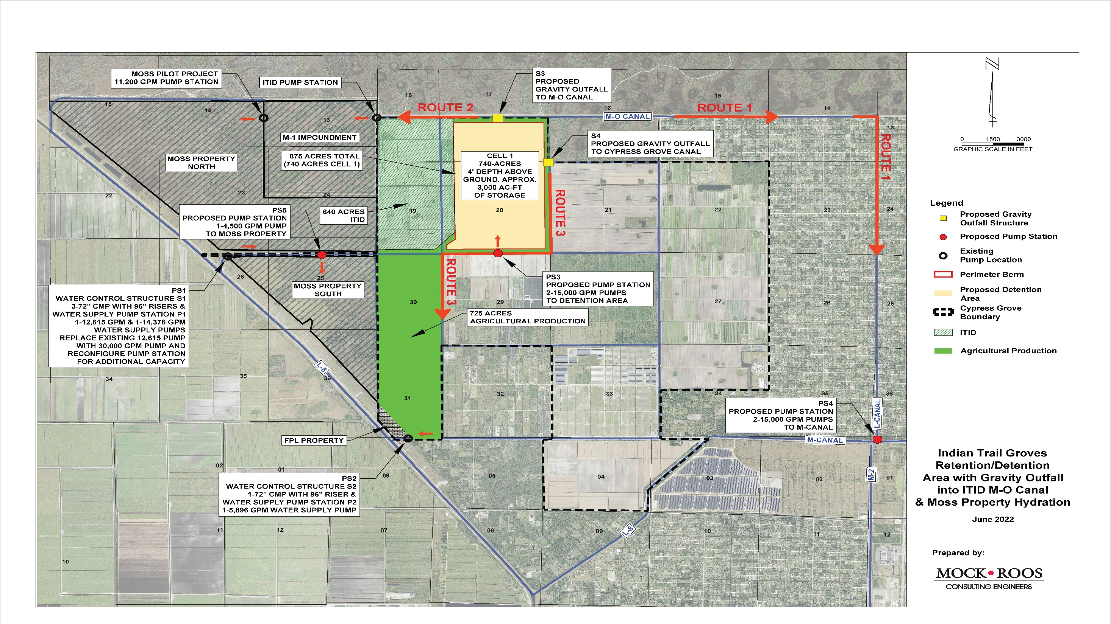

Slide 12
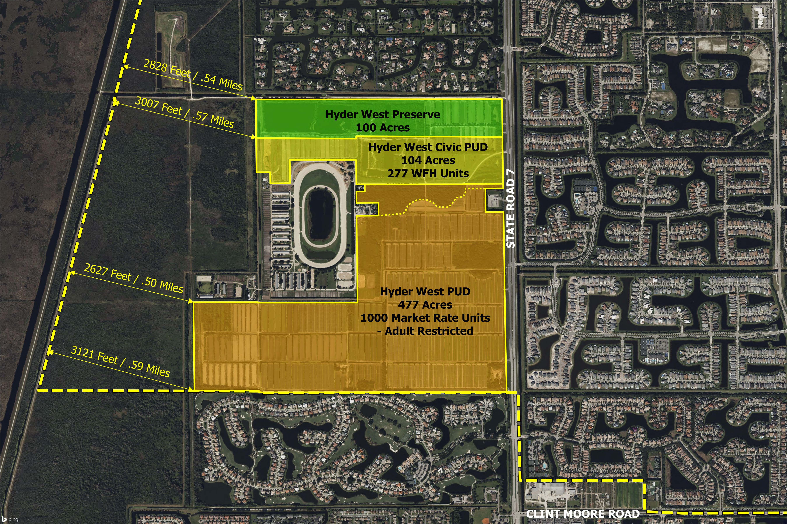

Slide 13
PALM BEACH COUNTY CONTROLLED LAND
Existing Acres
Proposed Acres
Indian Trails Ag/WR/OS
0
1,600
Hyder West
- Park Dedication
0
100
- Civic Dedication
0
25
Totals
0
1,725
Notes:
Sample Text with Clicks:
This chart shows…
The first line… (CLICK) Indian Trails…
The second/third line… (CLICK) Hyder West park dedication…
The fourth line… (CLICK) Civic Dedication…
The fifth line… (CLICK) Totals…
(CLICK)

Slide 14
WORKFORCE HOUSING ANALYSIS
Existing
Proposed
Approved
Units
WFH Units
Required
Proposed
Units
WFH Units
Proposed
Indian Trails Grove
3,897
390
2,612
261
Hyder West PUD and Hyder West Civic PUD
0
0
1,277
277
Total WFH Units
390
538
Difference
+148
Notes:
Sample Text with Clicks:
This chart shows the workforce housing…
The first line… (CLICK) Indian Trails Grove…
The second line… (CLICK) Hyder West PUD & Civic PUD…
The third line… (CLICK) Total WFH Units…
The final line… (CLICK) the Difference…
(CLICK)

Slide 15
Hyder West Civic PUD – Workforce Housing (WFH) Analysis
For Sale – Condo
Income Category | July 1, 2022 Maximum Sales Price | Number of Units | Percentage
Low | 60% to 80% | 38 | 25%
Moderate 1 | >80% to 100% | 38 | 25%
Moderate 2 | >100% to 120% | 38 | 25%
Middle | >120% to 140% | 38 | 25%
TOTAL |  | 152 | 100%
Rental
Income Category | Income Category Split | Number of Units | Bedrooms/Bathrooms
Low | 60% to 80% | 32 | 2 BDR/2 BATH
Moderate 1 | >80% to 100% | 31 | 2 BDR/2 BATH
Moderate 2 | >100% to 120% | 31 | 3 BDR/2.5 BATH
Middle | >120% to 140% | 31 | 3 BDR/2.5 BATH
TOTAL |  | 125

Slide 16
SUMMARY OF BENEFITS TO PALM BEACH COUNTY:
ITG is entitled with 3,897 units. If GL Proposal is rejected, the County loses the following benefits:
PBC owning 1,600 acres at ITG which would have included a completed water project/impoundment area holding approximately 3,000 acre feet of water storage. The water project would have directly benefited the Lake Worth Lagoon, Grassy Waters Preserve and the Loxahatchee River.
277 Workforce Housing Units on Hyder West. GL Homes further agreeing to complete construction of the WFH units concurrent with adjoining PUD (277 COs on Hyder West = 277 CO’s WFH).
A new Passive Park built by GL Homes and conveyed to PBC catering to both pedestrian and equestrian users.
25 acres (net) of Public Civic sites on Hyder West.
Over $500 Million of Additional Tax Base for the County
Hydration of southerly Moss property.

